Slide 1
Learning Objective
CFU
What will we learn today?
I will be able to factorise quadratic equations using completing the square
CFU
How will you know that you are successful?
Success Criteria
At the end of the lesson, I will be able to:
Factorise quadratic equations using completing the square

Slide 2
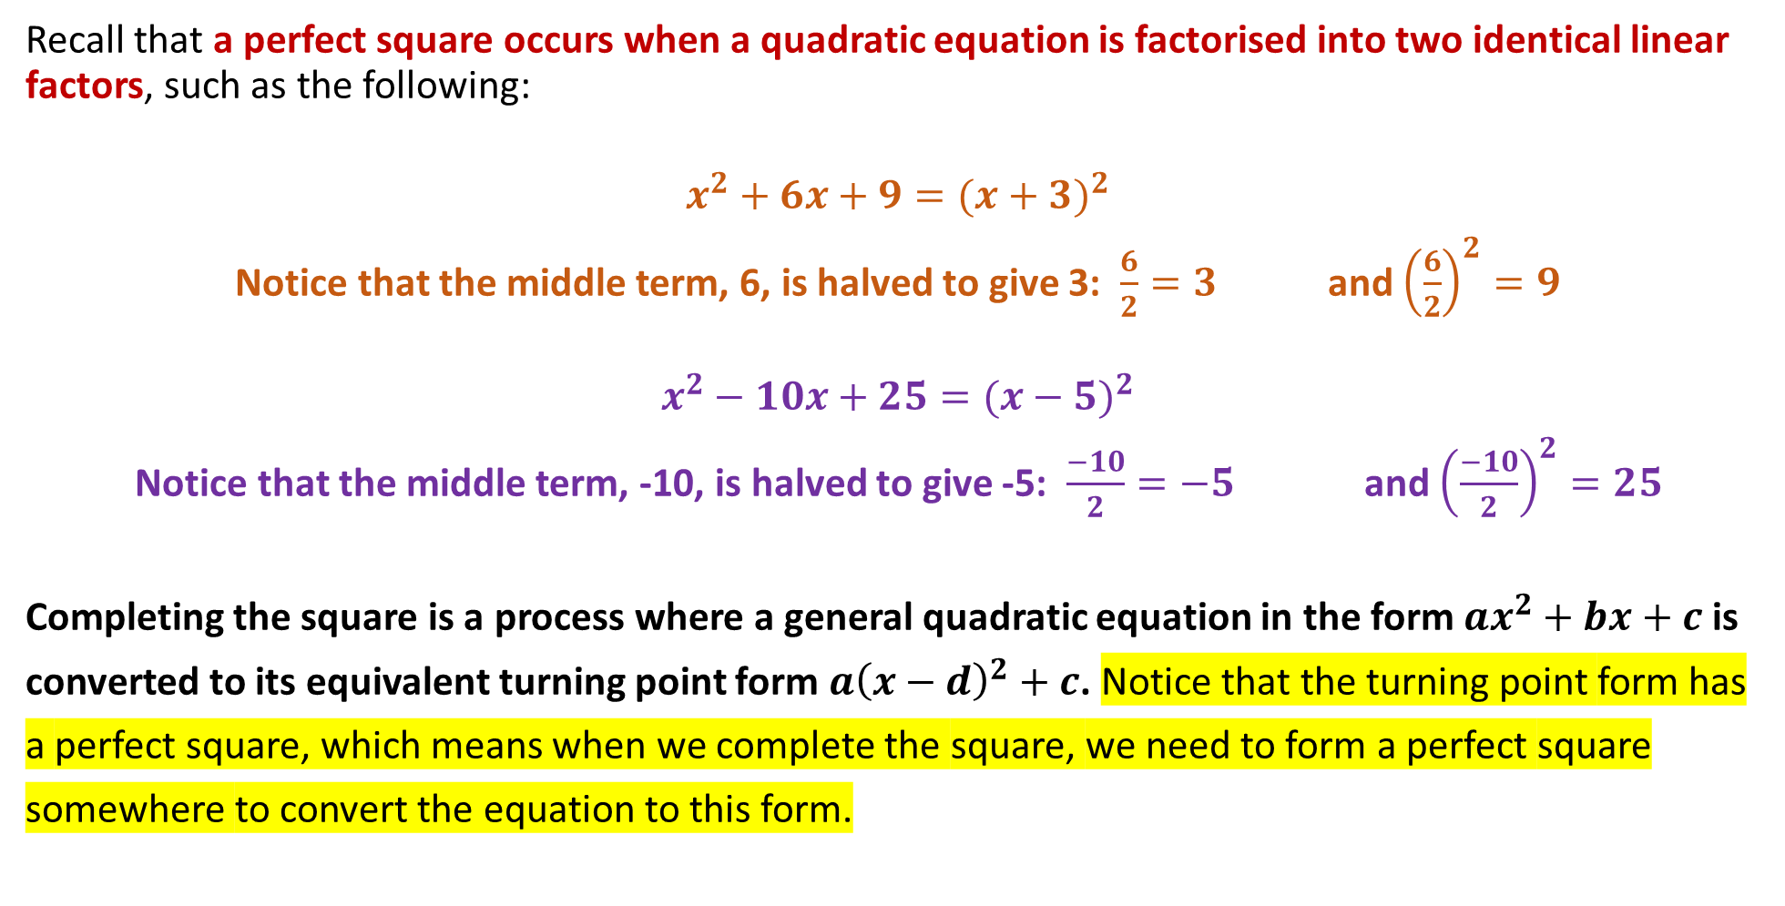
REVIEW: Perfect Squares
Recall that a perfect square occurs when a quadratic equation is factorised into two identical linear factors, such as the following:
$$x^{2}+6x+9={(x+3)}^{2}$$
Notice that the middle term, 6, is halved to give 3: $\frac{6}{2}=3$ and ${\left(\frac{6}{2}\right)}^{2}=9$
$$x^{2}−10x+25={(x−5)}^{2}$$
Notice that the middle term, -10, is halved to give -5: $\frac{−10}{2}=−5$ and ${\left(\frac{−10}{2}\right)}^{2}=25$
Completing the square is a process where a general quadratic equation in the form ${ax}^{2}+bx+c$is
converted to its equivalent turning point form $a{\left(x−d\right)}^{2}+c$. Notice that the turning point form has
a perfect square, which means when we complete the square, we need to form a perfect square
somewhere to convert the equation to this form.

Slide 3
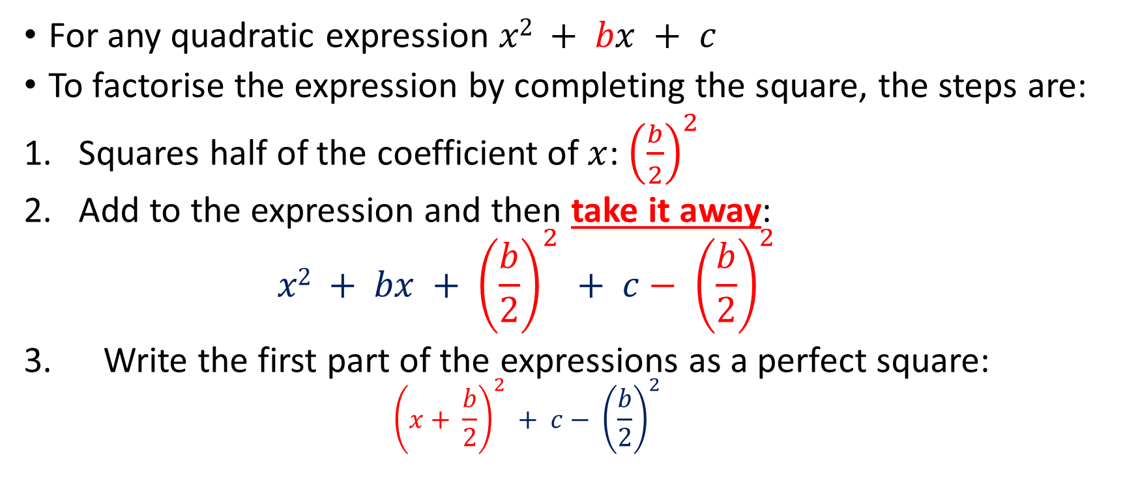
Factorise by completing the square
Completing the Square
For any quadratic expression $x2 + bx + c$
To factorise the expression by completing the square, the steps are:
Squares half of the coefficient of $x$: ${\left(\frac{b}{2}\right)}^{2}$
Add to the expression and then take it away:
$$x2 + bx + {\left(\frac{b}{2}\right)}^{2} + c− {\left(\frac{b}{2}\right)}^{2}$$
Write the first part of the expressions as a perfect square:
$${\left(x+ \frac{b}{2}\right)}^{2} + c− {\left(\frac{b}{2}\right)}^{2}$$
Evaluate

Slide 4




Completing the Square
To demonstrate the completing the square method, suppose we have the quadratic equation:
$$x^{2}+2x−3$$
STEP 1: Leave a gap between the
middle term and the constant.
STEP 2: Halve the value of b in the
quadratic (i.e. b = 2) and square it.
ADD it to x² + 2x and SUBTRACT it
from the constant -3.
STEP 3: Notice the LHS represents
a perfect square. Keep it separate
from the RHS of -4.
STEP 4: Factorise the LHS to a perfect
square, and leave -4 outside. The
equation is now in turning point form.

Slide 5





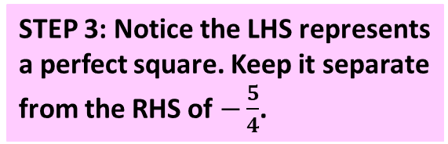
Completing the Square
As another worked example, suppose we have the quadratic equation:
$$x^{2}−3x+1$$
STEP 1: Leave a gap between the
middle term and the constant.
STEP 2: Halve the value of b in the
quadratic (i.e. b = -3) and square it.
ADD it to x² – 3x and SUBTRACT it
from the constant 1.
STEP 3: Notice the LHS represents
a perfect square. Keep it separate
from the RHS of $−\frac{5}{4}$.
STEP 4: Factorise the LHS to a perfect
square, and leave -4 outside. The
equation is now in turning point form.

Slide 6
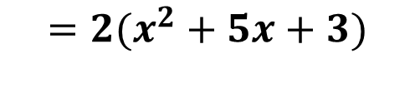

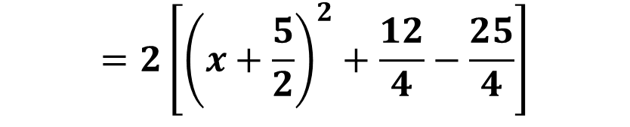

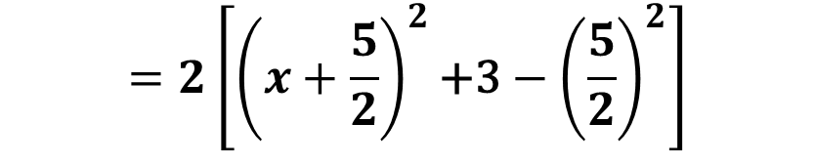
Factorise by completing the square
Completing the Square
$2x2+10x+6$
$$=2(x^{2}+5x+3)$$
$$=2\left[{\left(x+\frac{5}{2}\right)}^{2}\text{+3}−{\left(\frac{5}{2}\right)}^{2}\right]$$
$$=2\left[{\left(x+\frac{5}{2}\right)}^{2}+\frac{12}{4}−\frac{25}{4}\right]$$
$$=2\left[{\left(x+\frac{5}{2}\right)}^{2}−\frac{13}{4} \right]$$

Slide 7
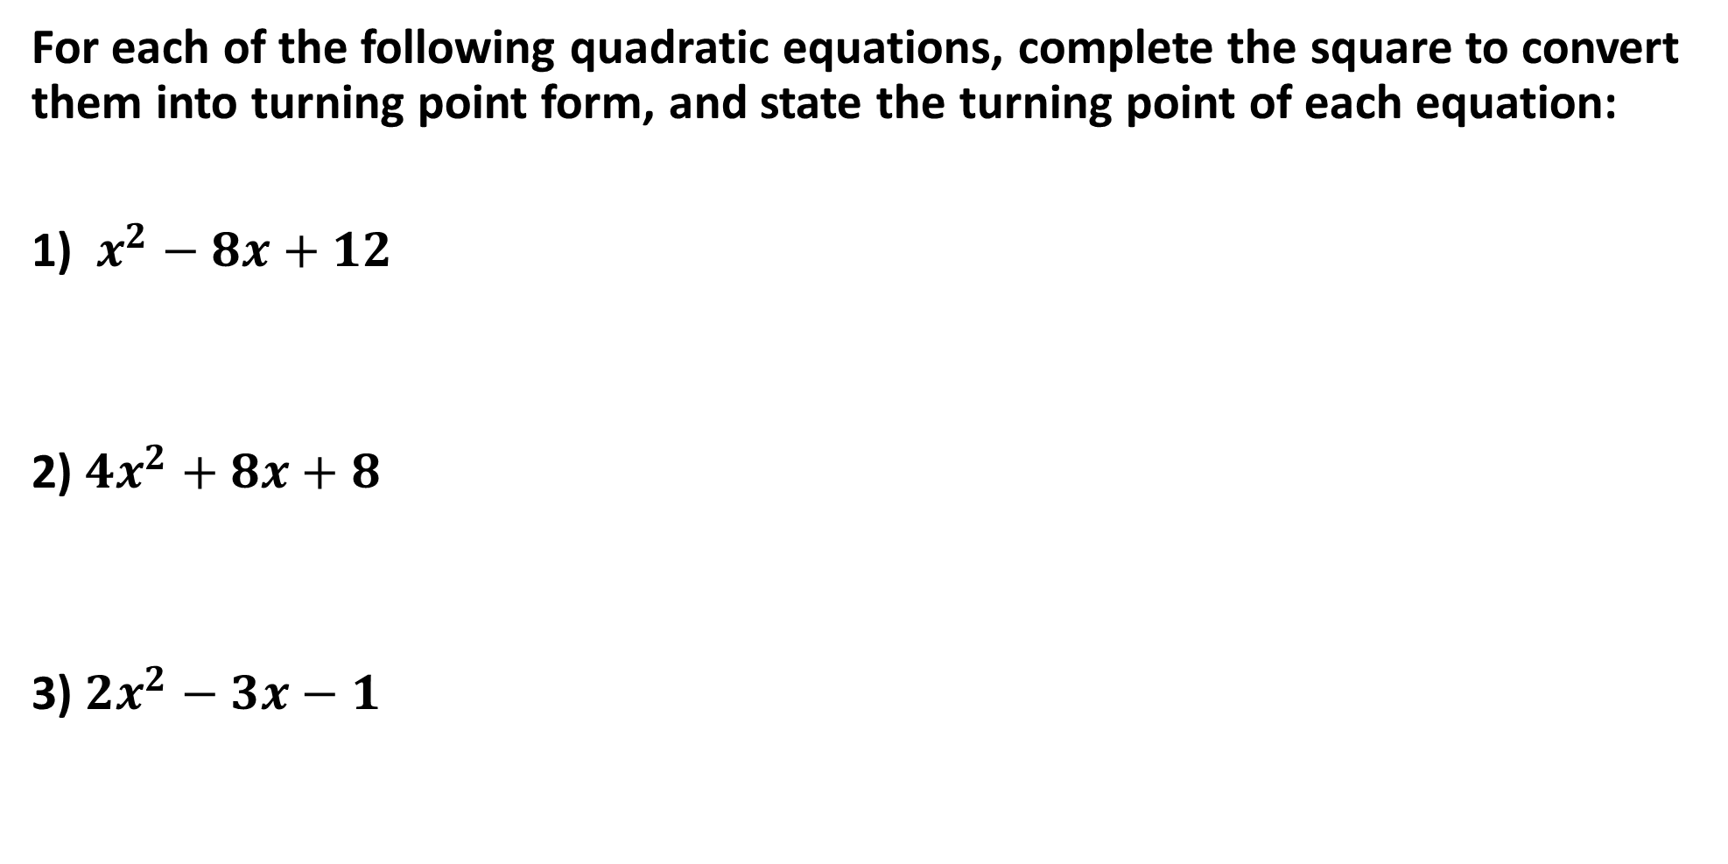
Completing the Square
For each of the following quadratic equations, complete the square to convert them into turning point form, and state the turning point of each equation:
1) $x^{2}−8x+12$
2) ${4x}^{2}+8x+8$
3) ${2x}^{2}−3x−1$

Slide 8
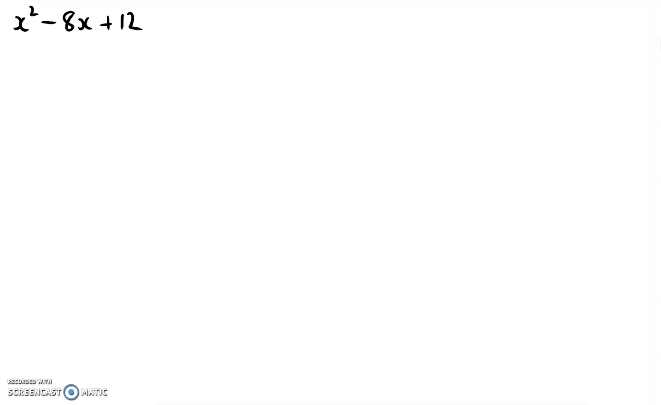
Completing the Square

Slide 9
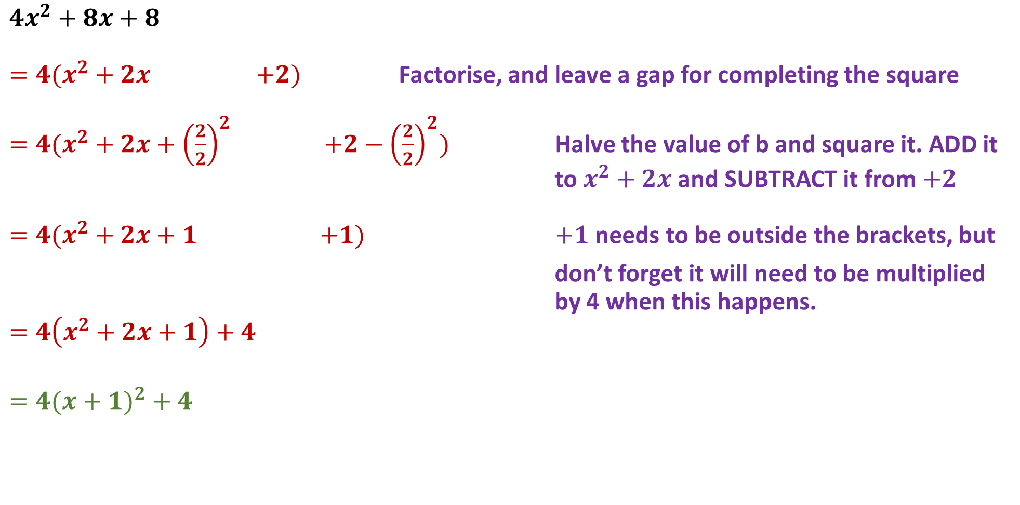
Completing the Square
$$4x^{2}+8x+8$$
$=4(x^{2}+2x$ $+2)$ Factorise, and leave a gap for completing the square
$=4(x^{2}+2x+{\left(\frac{2}{2}\right)}^{2}$ $+2−{\left(\frac{2}{2}\right)}^{2})$ Halve the value of b and square it. ADD it to $x^{2}+2x$ and SUBTRACT it from $+2$
$=4(x^{2}+2x+1$ $+1)$ $+1$ needs to be outside the brackets, but
don’t forget it will need to be multiplied by 4 when this happens.
$$=4\left(x^{2}+2x+1\right)+4$$
$$=4(x+1)^{2}+4$$

Slide 10
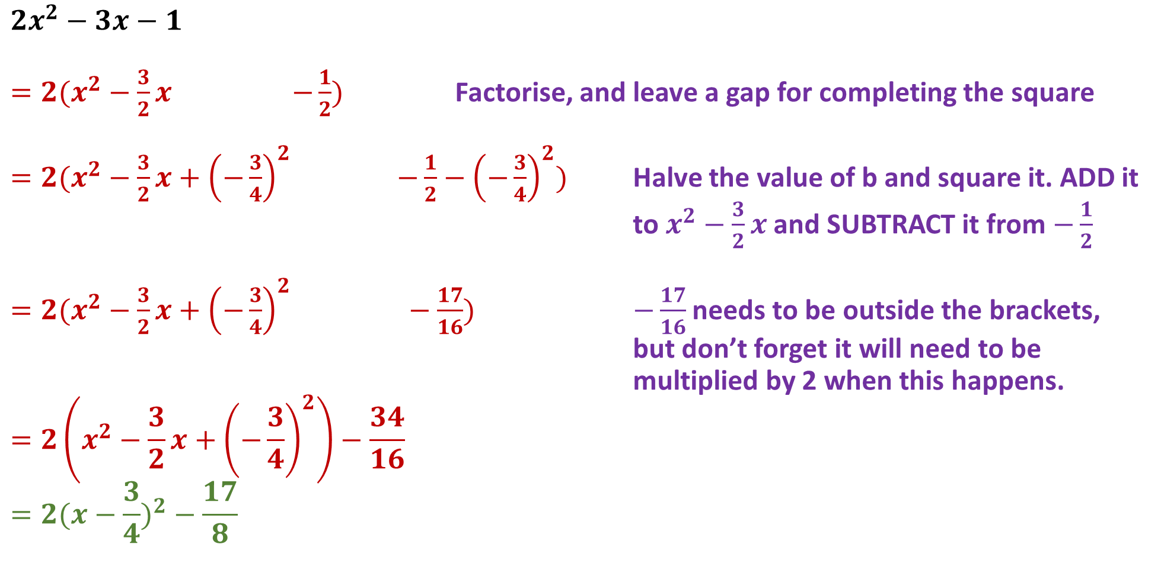
Completing the Square
$${2x}^{2}−3x−1$$
$=2(x^{2}−\frac{3}{2}x$ $−\frac{1}{2})$ Factorise, and leave a gap for completing the square
$=2(x^{2}−\frac{3}{2}x+{\left(−\frac{3}{4}\right)}^{2}$ $−\frac{1}{2}−{\left(−\frac{3}{4}\right)}^{2})$ Halve the value of b and square it. ADD it to $x^{2}−\frac{3}{2}x$ and SUBTRACT it from $−\frac{1}{2}$
$=2(x^{2}−\frac{3}{2}x+{\left(−\frac{3}{4}\right)}^{2} −\frac{17}{16})$ $−\frac{17}{16}$needs to be outside the brackets, but don’t forget it will need to be multiplied by 2 when this happens.
$$=2\left(x^{2}−\frac{3}{2}x+{\left(−\frac{3}{4}\right)}^{2}\right)−\frac{34}{16}$$
$$=2(x−\frac{3}{4})^{2}−\frac{17}{8}$$

Slide 11

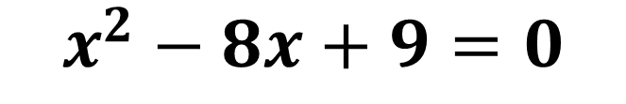
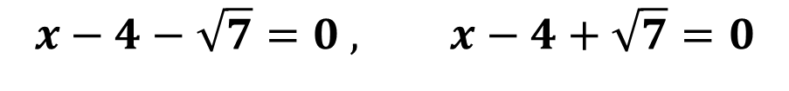

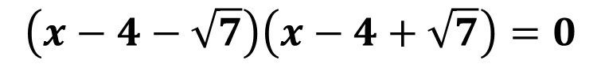
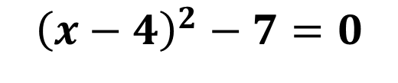
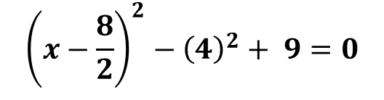
Solve for $x$using the method of completing the square
Completing the Square
$$x^{2}−8x+9=0$$
$${\left(x−\frac{8}{2}\right)}^{2}−{\left(4\right)}^{2}+ 9=0$$
$${\left(x−4\right)}^{2}−7=0$$
$$\left(x−4−\sqrt{7}\right)\left(x−4+\sqrt{7}\right)=0$$
$$x−4−\sqrt{7}=0 , x−4+\sqrt{7}=0$$
$$x=4+\sqrt{7}, x=4−\sqrt{7}$$

Slide 12
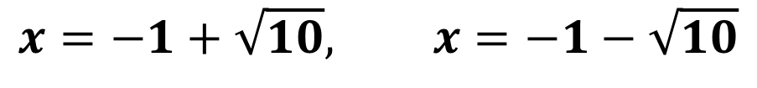

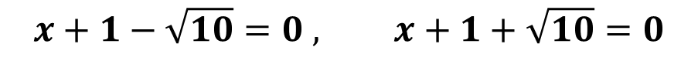

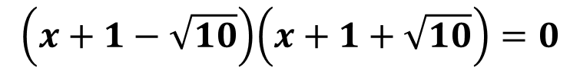

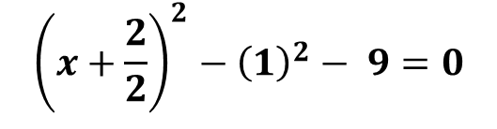
Completing the Square
Solve for $x$ using the method of completing the square
$$x2 + 2x − 9 = 0$$
$${\left(x+\frac{2}{2}\right)}^{2}−{\left(1\right)}^{2}− 9=0$$
$${\left(x+1\right)}^{2}−10=0$$
$$\left(x+1−\sqrt{10}\right)\left(x+1+\sqrt{10}\right)=0$$
$$x+1−\sqrt{10}=0 , x+1+\sqrt{10}=0$$
$$x=−1+\sqrt{10}, x=−1−\sqrt{10}$$

Slide 13
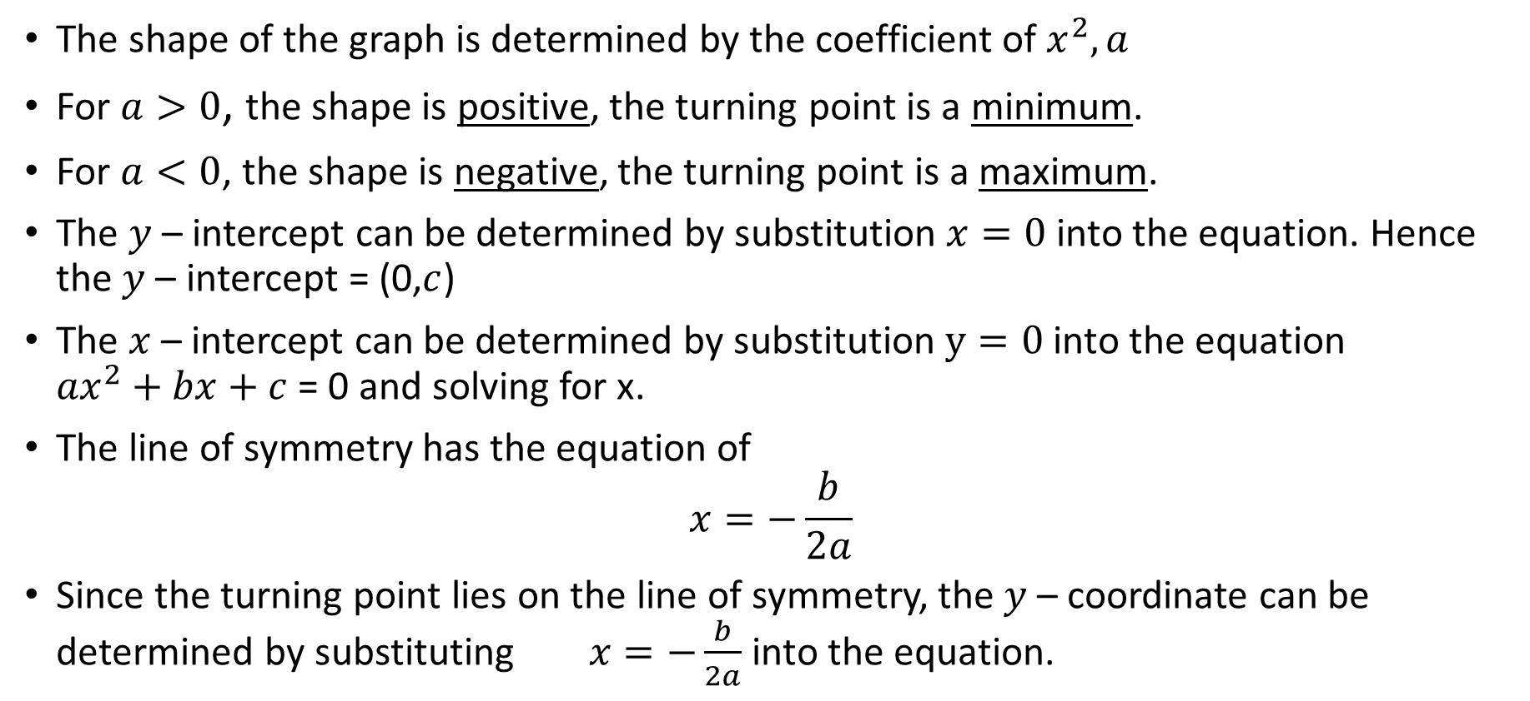

The general form of a quadratic equation $$y={ax}^{2}+bx+c$$
Concept Development
The shape of the graph is determined by the coefficient of $x^{2}, a$
For $a>0$, the shape is positive, the turning point is a minimum.
For $a<0$, the shape is negative, the turning point is a maximum.
The $y$ – intercept can be determined by substitution $x=0$ into the equation. Hence the $y$ – intercept = (0,$c$)
The $x$ – intercept can be determined by substitution $y=0$ into the equation ${ax}^{2}+bx+c$ = 0 and solving for x.
The line of symmetry has the equation of
$$x=−\frac{b}{2a}$$
Since the turning point lies on the line of symmetry, the $y$ – coordinate can be determined by substituting $x=−\frac{b}{2a}$ into the equation.

Slide 14
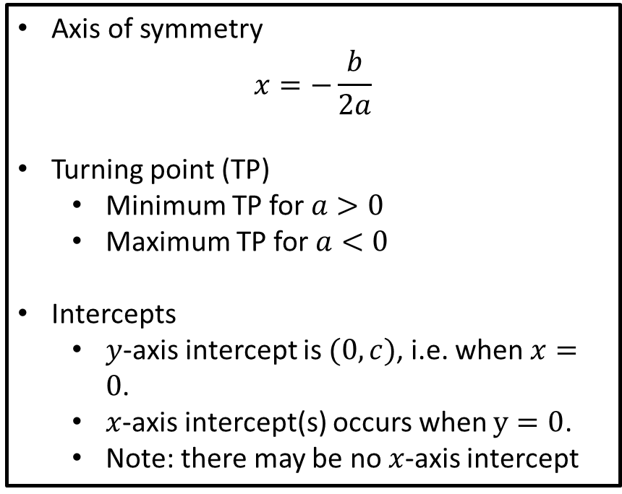

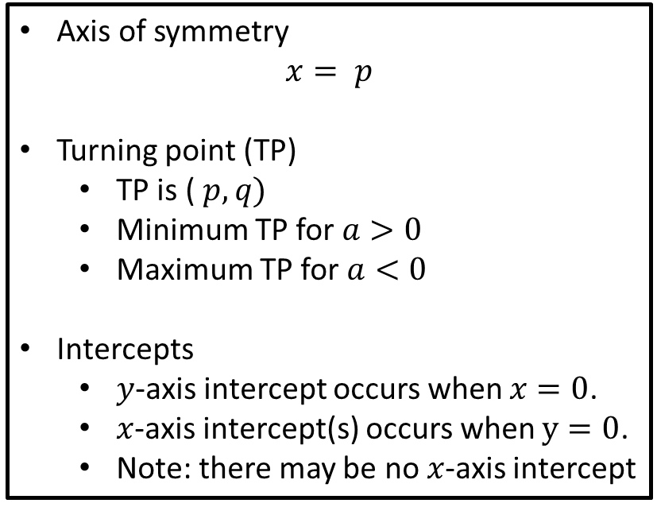

General form Turning Point form
General to Turning point
Complete the Square
Expand
$$y= {ax}^{2}+bx+c$$
$$y= {a(x−p)}^{2}+q$$
Axis of symmetry
$$x=−\frac{b}{2a}$$
Turning point (TP)
Minimum TP for $a>0$
Maximum TP for $a<0$
Intercepts
$y$-axis intercept is $(0,c)$, i.e. when $x=0$.
$x$-axis intercept(s) occurs when $y=0$.
Note: there may be no $x$-axis intercept
Axis of symmetry
$$x= p$$
Turning point (TP)
TP is ($p, q)$
Minimum TP for $a>0$
Maximum TP for $a<0$
Intercepts
$y$-axis intercept occurs when $x=0$.
$x$-axis intercept(s) occurs when $y=0$.
Note: there may be no $x$-axis intercept

Slide 15
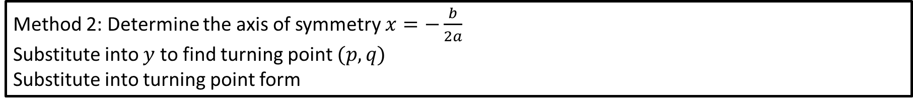
General form Turning Point form
Converting General to Turning Point
$$y= {ax}^{2}+bx+c$$
$$y= {a(x−p)}^{2}+q$$
Method 1: Complete the square
Method 2: Determine the axis of symmetry $x=−\frac{b}{2a}$
Substitute into $y$ to find turning point $(p,q)$
Substitute into turning point form

Slide 16

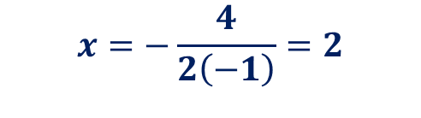



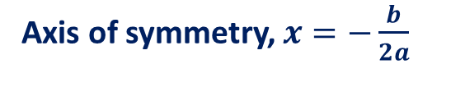

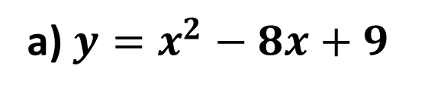

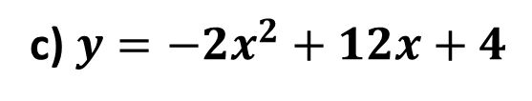


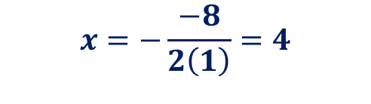

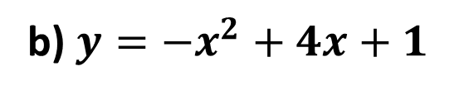
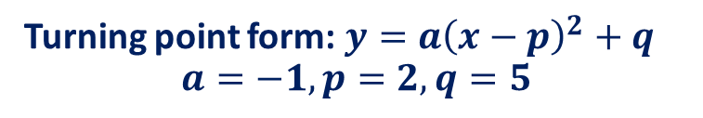
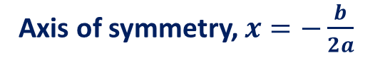
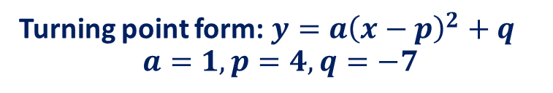

Determine the turning point form by finding the axis of symmetry
Turning Point form
a) $y=x^{2}−8x+9$
b) $y={−x}^{2}+4x+1$
c) $y={−2x}^{2}+12x+4$
$$a=1, b=−8, c=9$$
$$a=−1, b=4, c=1$$
Axis of symmetry, $x=−\frac{b}{2a}$
Axis of symmetry, $x=−\frac{b}{2a}$
$$x=−\frac{−8}{2\left(1\right)}=4$$
$$x=−\frac{4}{2\left(−1\right)}=2$$
Subst. $x=4, y={\left(4\right)}^{2}−8\left(4\right)+9$
Subst. $x=2, y=−{\left(2\right)}^{2}+4\left(2\right)+1$
$$y=−7$$
$$y=5$$
Turning point $(4,−7)$
Turning point $(2,5)$
Turning point form: $y=a{\left(x−p\right)}^{2}+q$ $$a=1,p=4,q=−7$$
Turning point form: $y=a{\left(x−p\right)}^{2}+q$ $$a=−1,p=2,q=5$$
Turning point form: $y={\left(x−4\right)}^{2}−7$
Turning point form: $y={−\left(x−2\right)}^{2}+5$

Slide 17



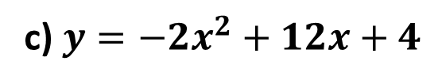
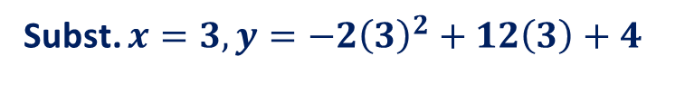
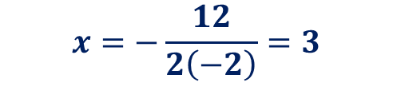

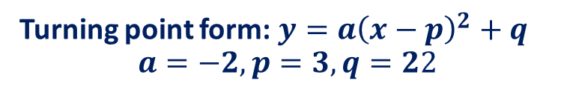
Determine the turning point form by finding the axis of symmetry
Turning point form
c) $y={−2x}^{2}+12x+4$
$$a=−2, b=12, c=4$$
Axis of symmetry, $x=−\frac{b}{2a}$
$$x=−\frac{12}{2\left(−2\right)}=3$$
Subst. $x=3, y={−2\left(3\right)}^{2}+12\left(3\right)+4$
$$y=22$$
Turning point $(3,22)$
Turning point form: $y=a{\left(x−p\right)}^{2}+q$ $$a=−2,p=3, q=22$$
Turning point form: $y={−2\left(x−3\right)}^{2}+22$

Slide 18

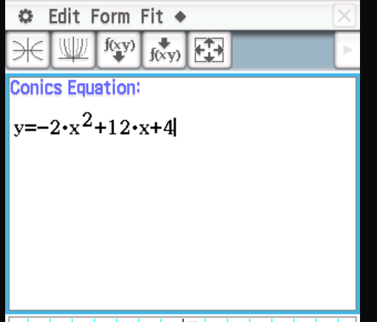

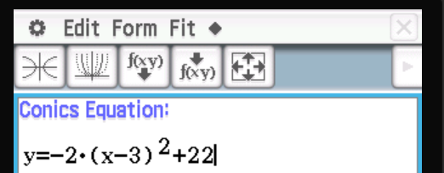
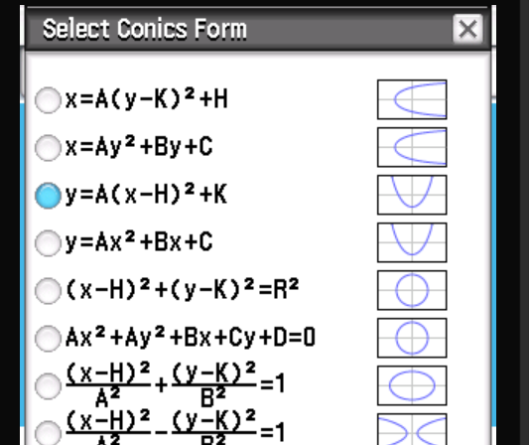
Determine the turning point form by finding the axis of symmetry
Classpad
c) $y={−2x}^{2}+12x+4$
Menu > Conics
Enter equation >EXE
FIT>Fit into Conics Form
Select Turning Point form

Slide 19
Cambridge Ex 3E
Independent Practice

